Slide 1
Drinkworks: Home Bar by Keurig
Case Study Report

Slide 2

Introduction
In the summer of 2018, Nathaniel Davis, CEO of Drinkworks, was going through the results of his company’s latest market research. Developed through a joint venture (JV) between home coffee-brewing and soft drink giant Keurig Dr. Pepper (KDP; operating as Keurig Green Mountain at the time) and global beer-brewing company Anheuser-Busch InBev (AB InBev), Davis’s team at Drinkworks created a home bar appliance that, similar to a Keurig coffee machine, used “pods” to make single-serving cocktails or beer with a touch of a button.
Since the founding of the JV, and leveraging technology from previous research and development (R&D) efforts of both parent companies, Davis and his team had developed and iterated the technology for the device, and now had to decide which target segment to focus on, whether to launch alcoholic cocktail pods or non-alcoholic cocktail mixer pods, and how to price both the device and the pods.

Slide 3

Problem Identification
The main of this case study is whether the Drinkworks will be the next billion-dollar opportunity.
To achieve the final answer, we will analyse the product in detail and the market it is trying to enter. We will also see how the product fits in the market and how it should be priced and marketed.
Finally we will make a SWOT analysis in order to understand what Drinkworks has to do to succeed.

Slide 4
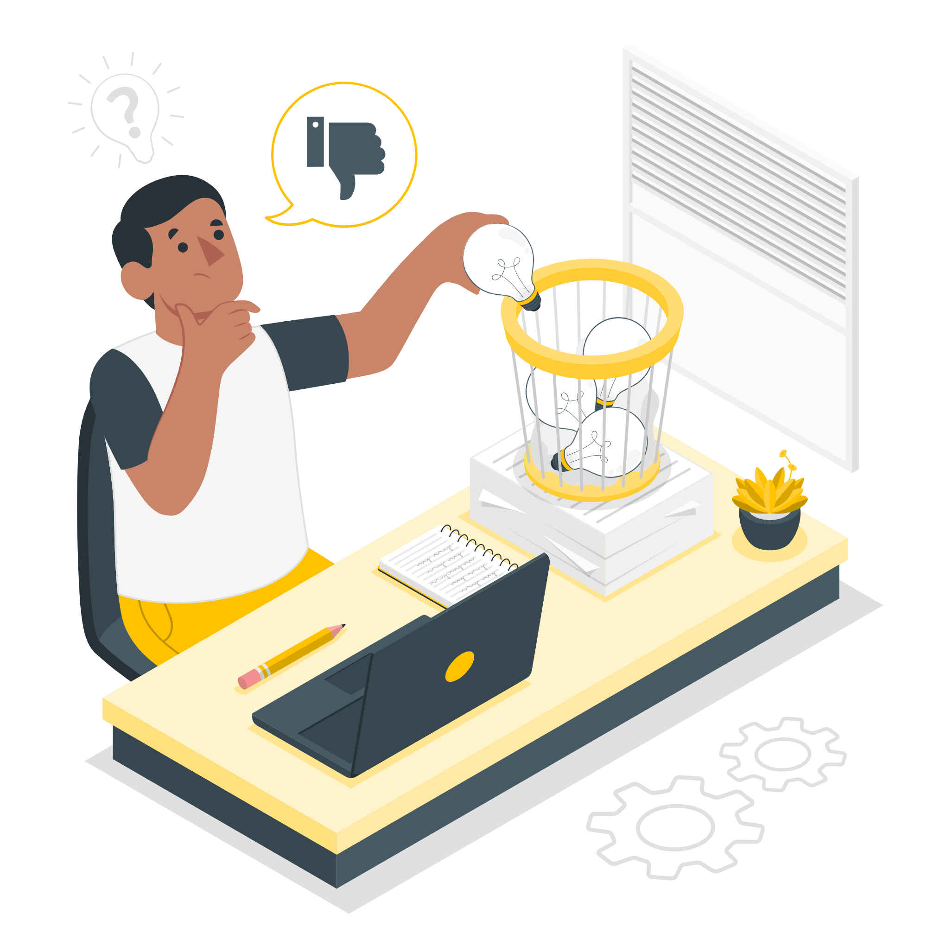
1. Is Drinkworks a good product? What problem is it trying to solve? What is its frame of reference?
Drinkworks is not a good product:
The target customer is too niche;
What they say about their target customer has some flaws;
The product doesn’t solve most of the problems it is trying to solve;
Compared to similar products in other markets, their products lack a lot of what makes the others successful;
Notes:
Drinkworks product is not a good product because their appeal is too niche, their perception of their target customer doesn't make much sense and the product doesn’t solve all the problems. It only makes sense for a person to buy the product if they are hosting a lot of parties with a lot of people. This is because, even if you like drinking cocktails but don’t like making them (the only group of people who would buy this product) it is cheaper to make your own cocktails and it is faster.

Slide 5
1. Is Drinkworks a good product? What problem is it trying to solve? What is its frame of reference?
Problems
Solved
Not Solved
Convenience
In the 10 minutes it takes to cool down, you can make a reasonable number of cocktails
Complexity
It makes it simpler, since you only have to use a pod.
Notes:
Drinkworks’ product is trying to solve the complexity of making a cocktail at home and make it more convenient. It really makes it simpler, since you only have to put a pod in the machine, but it is only more convenient if you have a lot of people or you don’t make cocktails at home. The machine takes 10 minutes to cool down and 1 minute to make a cocktail, in that time you can actually make a reasonable number of cocktails. If you don’t make cocktails at home, then the price they are asking is probably too much for a normal person to get into drinking cocktails at home (it would be cheaper just to buy the ingredients).

Slide 6
1. Is Drinkworks a good product? What problem is it trying to solve? What is its frame of reference?
Frame of Reference - Nespresso
 | Upfront Cost | Pod Cost | Start Up time | Convenience per Serving
Drinkworks | High | High | 10 minutes | Low
Nespresso | Almost 0 | Low | < 1 minute | High
Notes:
Their reference market is the pod coffee market. If we compare this product to, for example, a Nespresso product, this product makes no sense. The upfront cost of the product makes it inaccessible for most people. Nespresso offers their machine when you buy the pods so there really isn’t that much up front cost on the machine. The Nespresso machine also takes way less time to get ready (<1 minute), so the convenience level is way bigger since making an espresso from scratch takes at least 5 minutes. On the contrary, you can make a cocktail in less time than it takes the Drinkworks product to cool down.

Slide 7
2. How do you characterize the target market segment(s) of Drinkworks? What is its potential target market size?
Target customer
Yes
People that like making cocktails
People that like cocktails but don’t like making them
No
People that don’t like cocktails

Slide 8
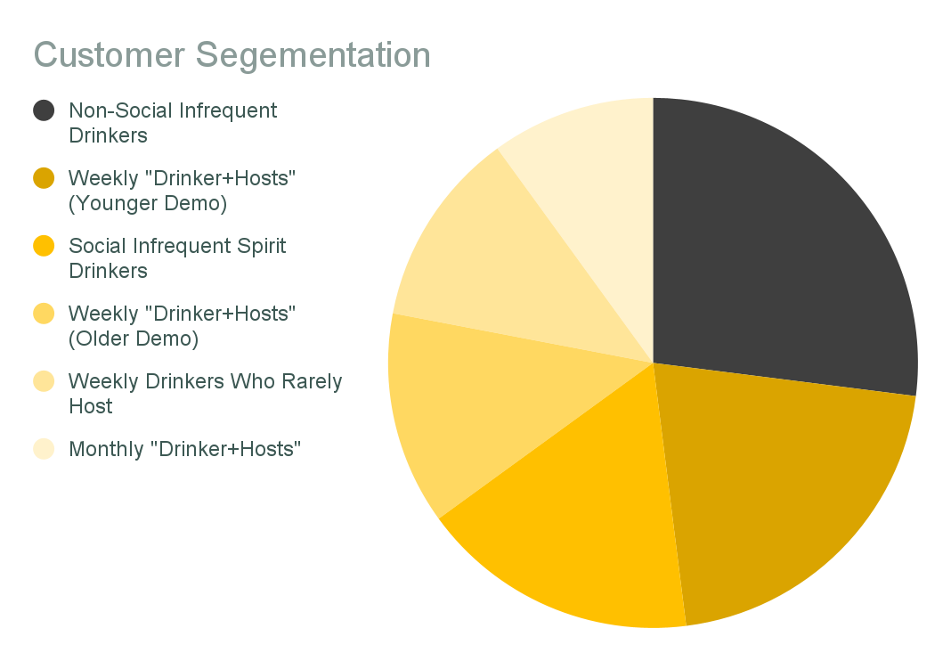
2. How do you characterize the target market segment(s) of Drinkworks? What is its potential target market size?
Demographic characteristics that should be analyzed:
Alcohol consumption frequency
Hosting frequency
Age
Keurig device ownership

Slide 9
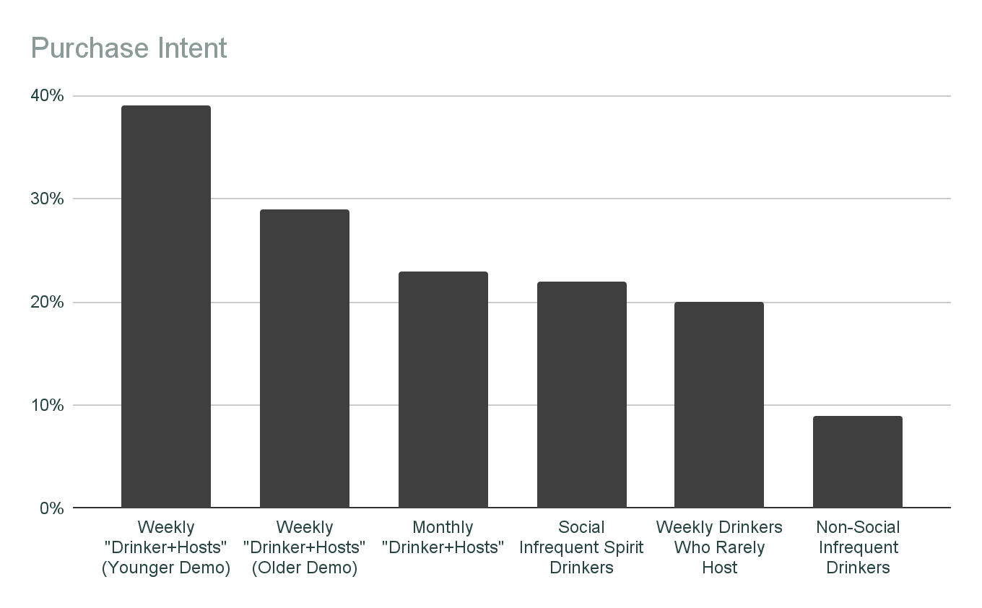
2. How do you characterize the target market segment(s) of Drinkworks? What is its potential target market size?
From the studies carried out by the company (pricing the appliance at $199 and the pods at $4), we can see that the product is more appealing to weekly drinkers who are also frequent party hosts.
This product would target, at most, 23% of the total market (US people, aged 25-64 that consumed any type of alcohol in the last four weeks). This is a small percentage, so we can consider this a niche business.

Slide 10
3. What is Drinkworks' value proposition, and what is its positioning in the market? What Pods should be introduced?
Convenience
Variety
Simplifies the task of making cocktails with one-touch operations.
Offers a lot of variety to the customers through the different available pods.

Slide 11
3. What is Drinkworks' value proposition, and what is its positioning in the market? What Pods should be introduced?
Drinkworks
Premium brand for cocktail making appliances, heavily associated with Keurig’s coffee machines and pods
Product
Extremely easy to use product that will step up the customer’s hosting experience.

Slide 12
3. What is Drinkworks' value proposition, and what is its positioning in the market? What Pods should be introduced?
Non-Alcoholic Mixer Pods Only
Alcoholic Pods Only
Alcoholic + Non-Alcoholic
No distribution hurdles
Are the easiest for consumers to understand
Allow customers to customize their cocktail by choosing their own liquor brand and amount
Goes against the company’s value proposition (decreases convenience)
Implicates more logistic and distribution work
Goes directly into the company’s value proposition
Could generate confusion among users because of different pod selling locations and the pods themselves would have different uses
Notes:
Pods:
Three approaches:
Non-Alcoholic Mixer pods only
Easiest approach since there will be no distribution hurdles. Furthermore, these pods are the easiest for consumers to understand and allow them to choose their favorite liquor brand and amount to add to the pod.
Goes against the company’s value proposition, since users would have to buy and add the liquor themselves, which decreases the product’s convenience.
Alcoholic pods (Beer/Cider and Cocktail) only
Implicates more logistic work and distribution will be a critical factor in the pods’ success.
Goes directly into the company’s value proposition
Both alcoholic and Non-Alcoholic pods
Could generate confusion among users (different selling locations for the pods and the pods themselves have different uses)

Slide 13
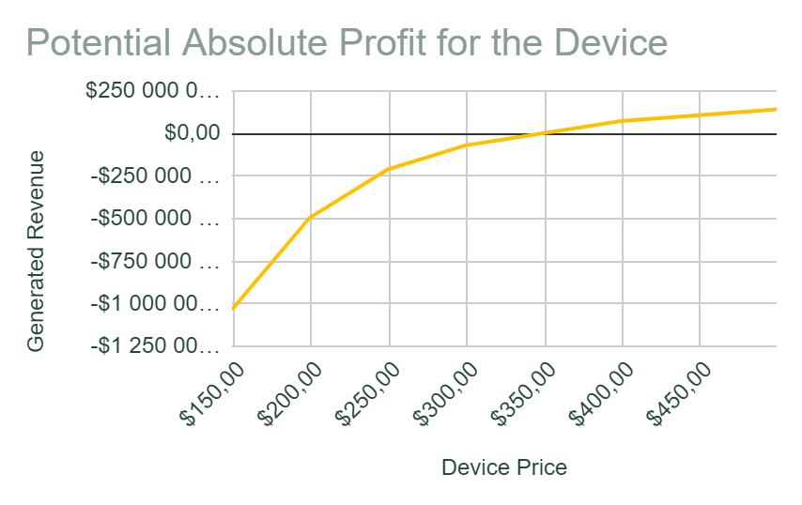
4. How should the device and Pods be priced?
The way Drinkworks will generate revenue is not through selling devices (one-time purchases), but rather through selling pods (need to be repurchased by the customer). Therefore the device might be priced lower to encourage customers to buy it. The lower the device’s price, the less revenue its sales will generate.
We believe the device should be priced at either $250 or $300, otherwise it will simply not be purchased by enough customers to make the business viable (only 2.1% of people are willing to pay $400 for the device). This would mean that the business would suffer a heavy loss in the beginning due to the device sales, but should recover once customers start buying pods.

Slide 14
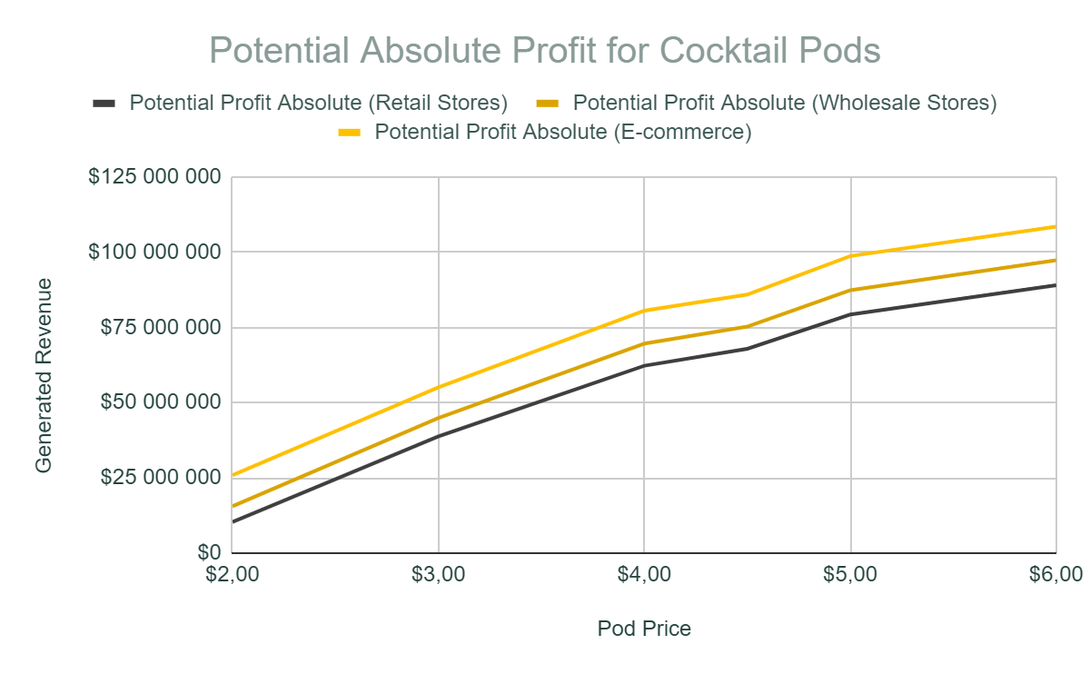
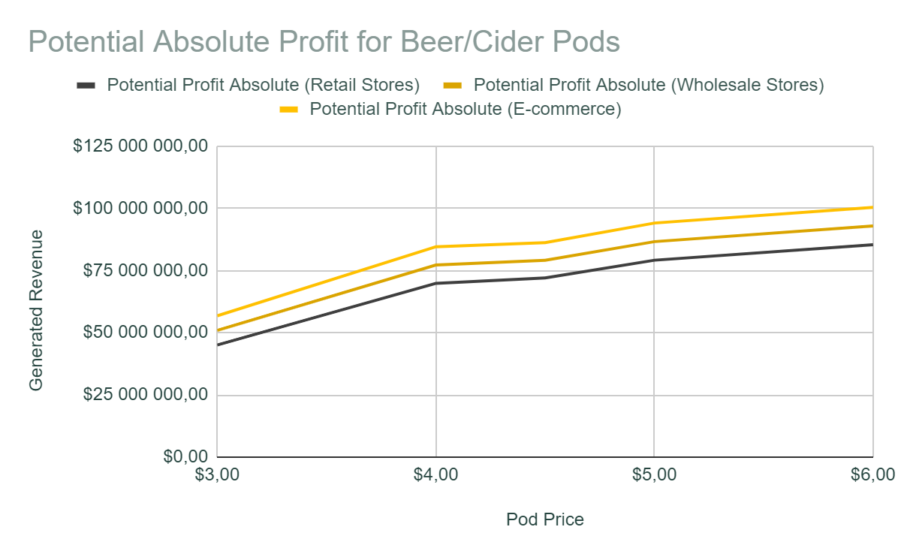
4. How should the device and Pods be priced?
For the alcoholic pods, the higher the pod price, the more revenue the company will generate with pod sales. Even though less people are willing to pay for pods at higher prices, the increase in price compensates for the decrease in customers. Therefore, the alcoholic pods should be priced at $6.00.

Slide 15
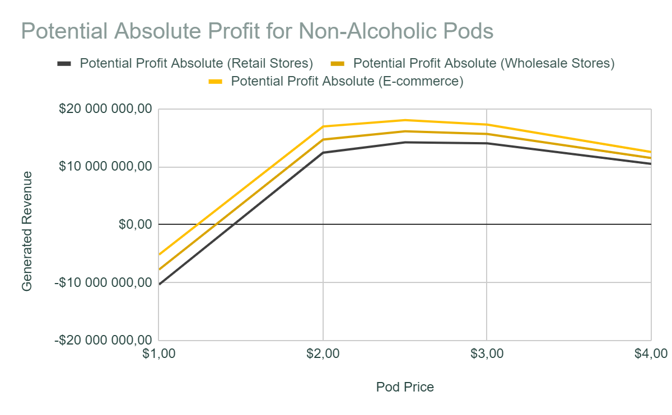
4. How should the device and Pods be priced?
Regarding non-alcoholic pods, the story is different. We can see the optimal price range for these pods is between $2.00 and $3.00. Priced at $2.50, the pods would generate the most revenue for the company and, therefore, this should be the price at which they are introduced to the market.

Slide 16
5. Will Drinkworks be the next billion-dollar opportunity of Keurig and AB InBev? What are the risk opportunities, and what would you recommend Keurig to do to address them?
SWOT Analysis
Strengths
Weaknesses
Keurig and AB InBev are already big players in the market
Long-lasting Product
Fast and easy process of making a cocktail
The device takes long to chill the water (10 minutes)
Leaving the device plugged in removes this waiting time, but the device is consuming energy when not being used
Notes:
SWOT Analysis
Strengths
Drinkworks can use Keurig and AB InBev’s names to market their product, which might give it some traction in the market;
The device can last long (5 or more years);
After the water is chilled, making a cocktail is extremely fast (around 1 minute).
Weaknesses
The device takes a lot of time to chill the water (10 minutes). The solution to this is to leave the device plugged in, but this is also not ideal since it consumes energy even when not being used (has to keep the water chilled).

Slide 17
5. Will Drinkworks be the next billion-dollar opportunity of Keurig and AB InBev? What are the risk opportunities, and what would you recommend Keurig to do to address them?
SWOT Analysis
Opportunities
Threats
Most households in the US have consumed any form of alcohol in the last weeks and this number is growing, which might mean that the potential market is growing.
Competitor company Bartesian (“Keurig of cocktails”) planning to launch nationwide.
Distribution of alcoholic goods is tricky in the US since there are a lot of regulations about it and they might change from state to state.
Notes:
SWOT Analysis
Strengths
Drinkworks can use Keurig and AB InBev’s names to market their product, which might give it some traction in the market;
The device can last long (5 or more years);
After the water is chilled, making a cocktail is extremely fast (around 1 minute).
Weaknesses
The device takes a lot of time to chill the water (10 minutes). The solution to this is to leave the device plugged in, but this is also not ideal since it consumes energy even when not being used (has to keep the water chilled).

Slide 18

5. Will Drinkworks be the next billion-dollar opportunity of Keurig and AB InBev? What are the risk opportunities, and what would you recommend Keurig to do to address them?
In our opinion, Drinkworks will not be the next billion-dollar opportunity of Keurig and AB InBev.
We believe the product targets a very niche market and, in order to be profitable, would have to be sold at high prices. Furthermore, it’s a difficult product to introduce to the market since people will likely not spend around 300$ in a device without knowing it works as expected first.

Slide 19

Authors
Class 3, Group 4
Beatriz Mendes, up201806551@edu.fe.up.pt
Bernardo Ramalho, up201704334@edu.fe.up.pt
Pedro Azevedo, up201806728@edu.fe.up.pt
Pedro Ponte, up201809694@edu.fe.up.pt
Tomás Fontes, up201806252@edu.fe.up.pt

